Slide 1
NASA Earth Exchange (NEX)
A collaborative supercomputing environment for global change science
Earth Science Division/NASA Advanced Supercomputing (NAS)
Ames Research Center http://www.nex.arc.nasa.gov
Rama Nemani (rama.nemani@nasa.gov)
Forrest Melton (forrest.s.melton@nasa.gov)
Petr Votava, Andrew Michaelis, Jennifer Dungan
April 26, 2012
Providing direct access to data, models, analysis tools, and scientific results through a supercomputing platform that fosters knowledge sharing, collaboration, and innovation.

Slide 2
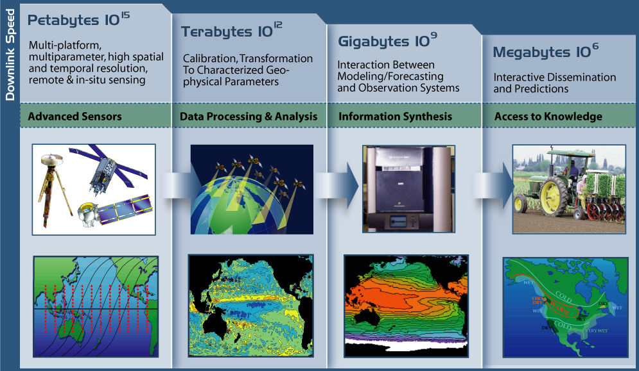
From data to knowledge/decisions
Turned out to be wishful thinking..

Slide 3
Motivation
Earth science at NASA is a community effort (179 institutions in the US published 5 or more papers (2000-2012) using MODIS data)
100s of investigators spend a majority of their time dealing with data
Redundant storage and processing facilities result in larger overall computing budgets
Moving data sets that are getting larger each year over WAN is expensive & time-consuming
Sharing knowledge (codes, intermediate results, workflows) is difficult
Limited capability exists to allow transparency, repeatability and extensibility

Slide 4
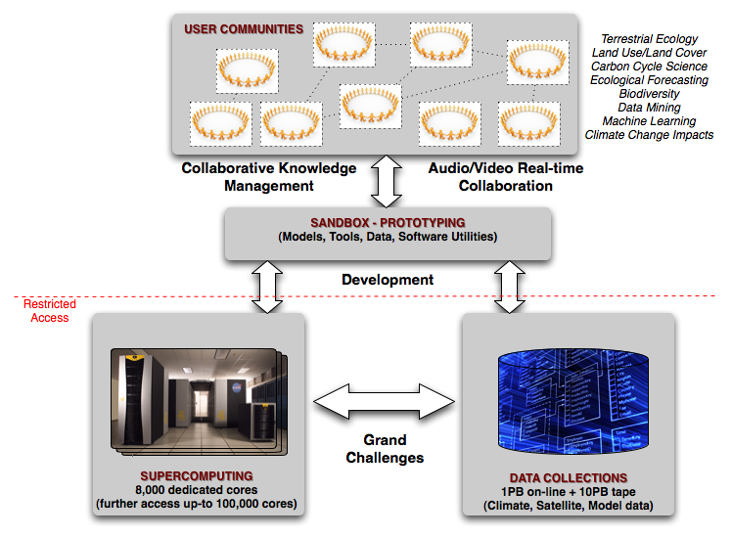
NASA Earth Exchange Components
Nemani et al., 2011, Trans. of Eos

Slide 5
NEX Status
Computing
  Supercomputing and storage through NASA Advanced Supercomputing Division (NAS)
  Almost 3PB storage, 512 - 8,000 CPU cores
Data
  Global MODIS, AVHRR, Landsat, GCM Scenarios, weather data, etc.
Models
  Publicly available models (ecosystem, weather, climate, hydrology)
Software Utilities
  Open source and commercial
Community (172 Members, 22 Active Research Teams)
  NEX portal currently includes information on all SMD Earth science projects

Slide 6
NEX Status
Users
  NEX team is completing requirements documents based for next phase based on feedback from initial user groups currently completing their projects.
  Next user/team selection will be based on NASA HQ recommendations.
Governance (User and Project Selection)
  Currently working with NASA HQ to develop NRA-based selection process for NEX.
Security
  Adhering to NASA moderate security access with two-factor authentication.
  NEX training workshop, July 16-27
  Presentations to be broadcast on-line
  http://nex.arc.nasa.gov

Slide 7
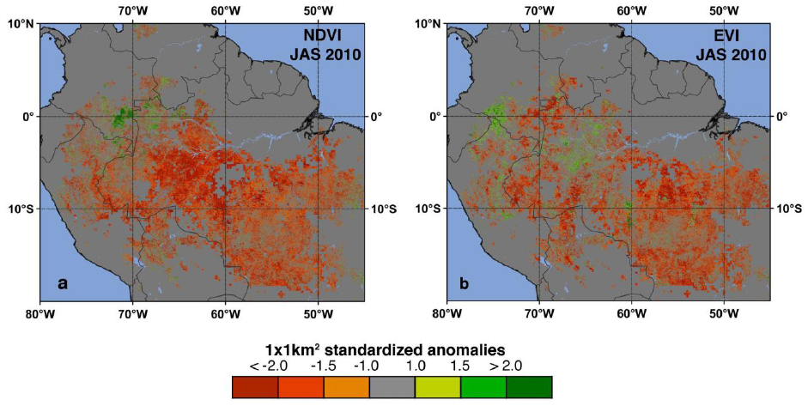
NEX Science: Accelerating Analysis
Accelerating Analysis with NEX: Satellite Measurements of Amazon Drought Impacts
Application of NEX to conduct rapid assessment of impacts of 2010 Amazon drought on tropical ecosystems (Xu et al., 2011, GRL 38)
Notes:
By leveraging data archive and pre-configured analysis environment, 2010 analysis completed in three weeks while analysis of similar event in 2005 required >9 months to complete

Slide 8
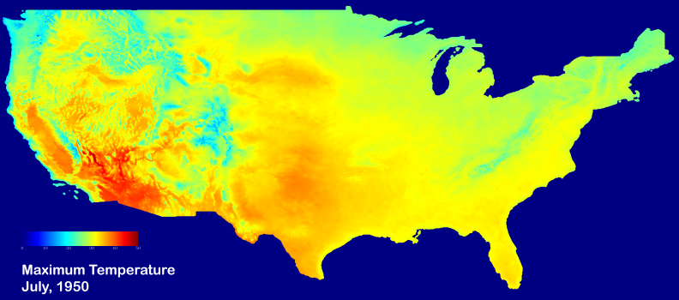
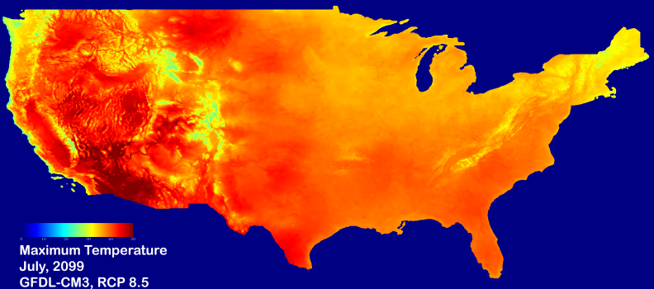
NEX Science: Accelerating Analysis
Downscaling of CMIP5 scenarios as they are made available (B. Thrasher / P. Duffy)
Ecosystem / carbon cycle models already implemented and ready to ingest downscaled climate data

Slide 9
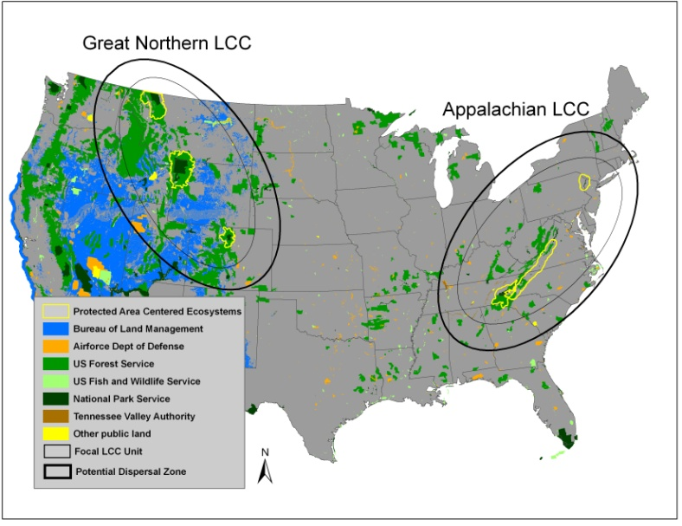
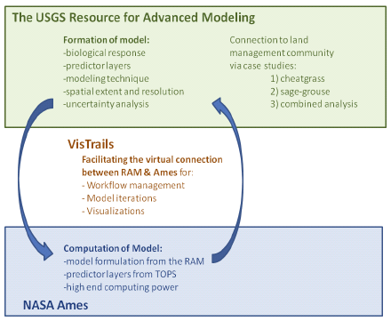
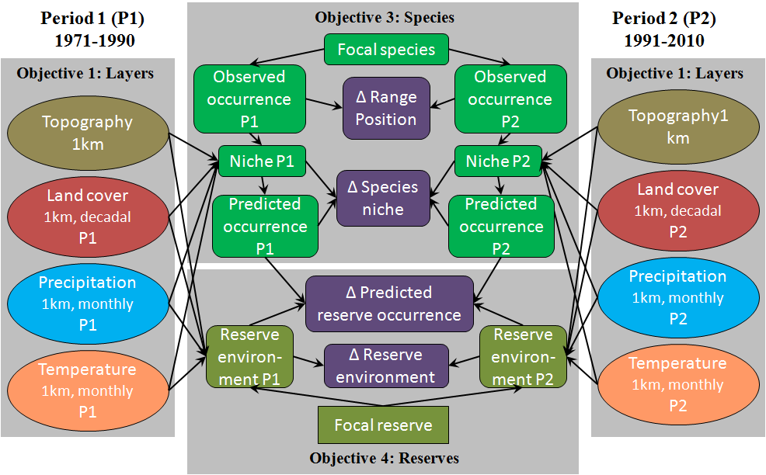
NEX Applications:
Climate and Biodiversity
Using the USGS “Resource for Advanced Modeling” to connect climate drivers to biological responses; PI: Jeff Morisette
Using NASA Resources to Inform Climate and Land Use Adaptation; PI: Andy Hansen
Integrating Global Species Distributions, Remote Sensing and Climate Station Data to Assess Biodiversity Response to Climate Change; PI: Walter Jetz
NEX provides data, modeling, and computing resources to accelerate application development and testing
High-end computing resources are not optimized for continuous, sustained low-CPU tasks
EC2 and other public clouds are candidates for operational hosts of applications prototyped on NEX

Slide 10
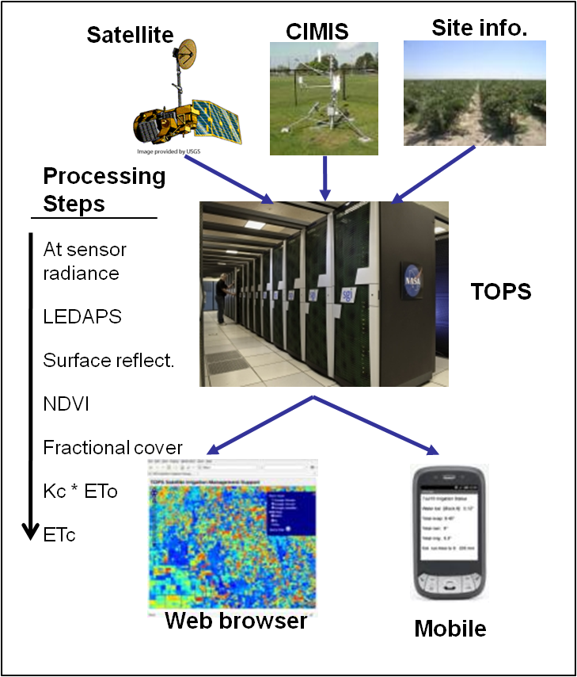
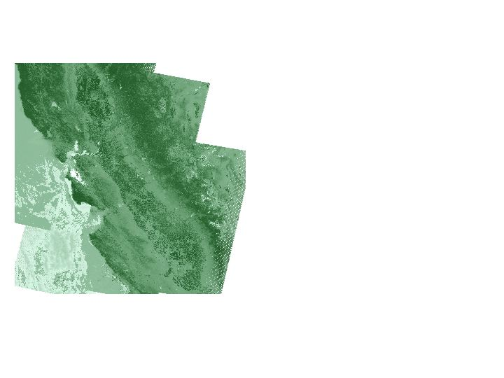
NEX Applications:
Crop Water Management
Weekly composites:
L5 & L7 & MODIS
NEX
Melton et al. (in press)

Slide 11
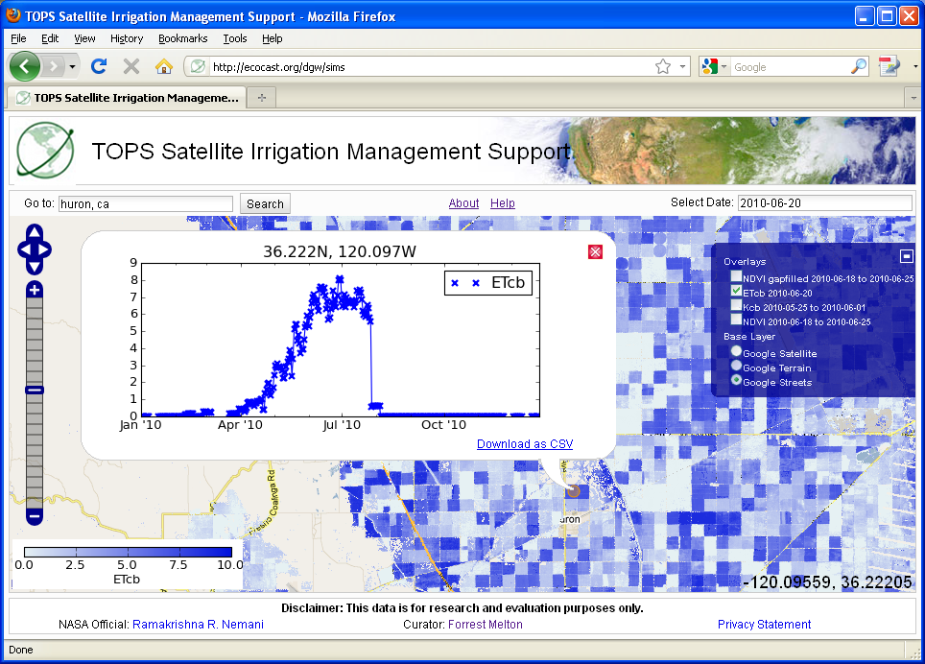
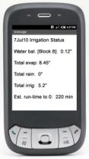
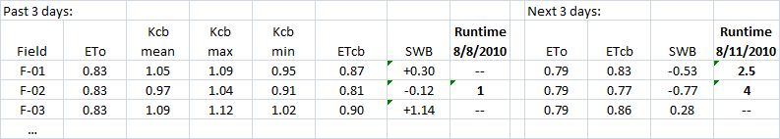
NEX Applications:
Crop Water Management
Weekly composites:
L5 & L7 & MODIS
Irrigation reports

Slide 12
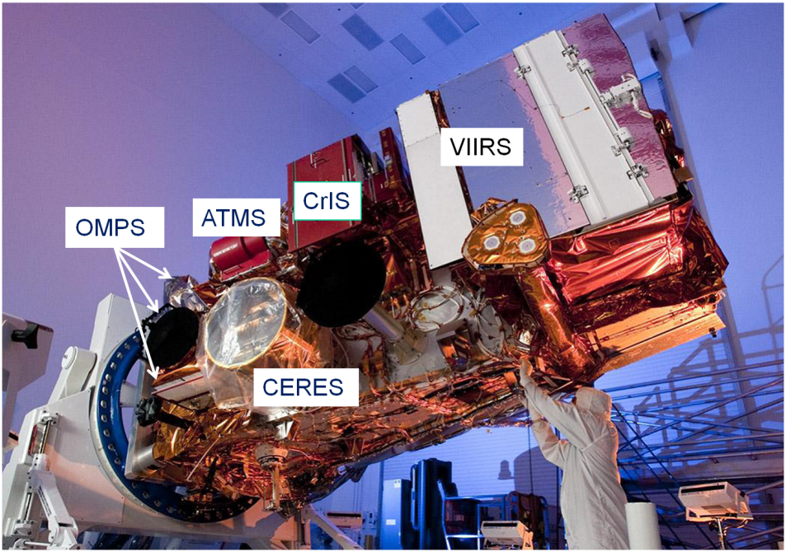
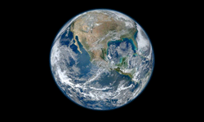
NEX Missions:
Suomi / NPP
Suomi / NPP Mission Support:
1) Understand the errors and uncertainties associated with the transition from MODIS to VIIRS
2) Integrate Suomi / NPP data and products into existing applications
3) Continue to engage federal, state and local partners in the NPP mission by providing a platform for creating high-level products and rapid prototyping of applications

Slide 13
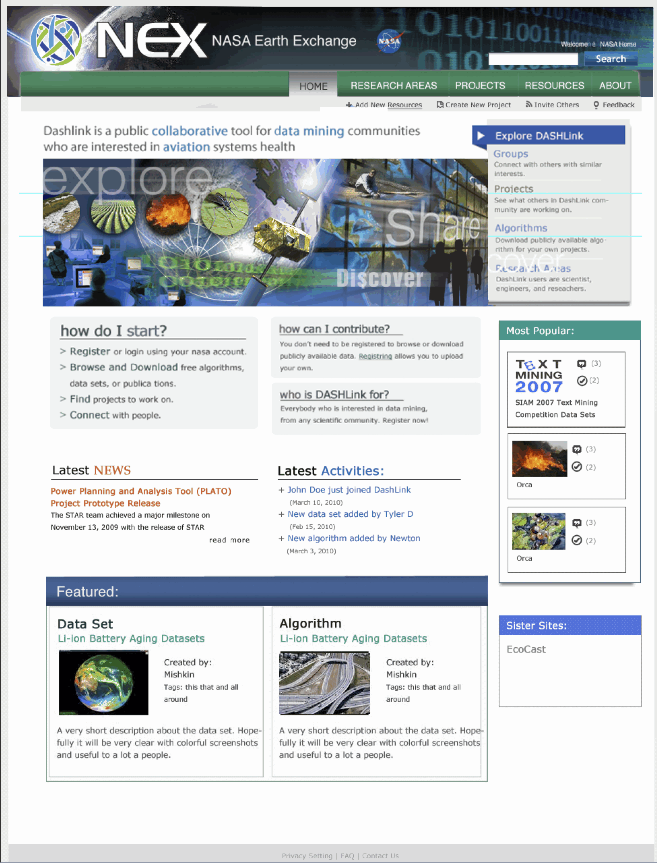
NEX Technology: Integrating Advances
Share
Virtual
Conference
Collaborate
Leveraging collaborative research tools at NASA
Visualize

Slide 14

Summary
Engage a larger community by lowering the barrier of entry by co-locating data, model codes, and compute resources
Capture research through workflows and virtual machines to create the ability to build on past work, and accelerate future scientific endeavors
Foster inter-disciplinary efforts
THINK BIG!

Slide 15
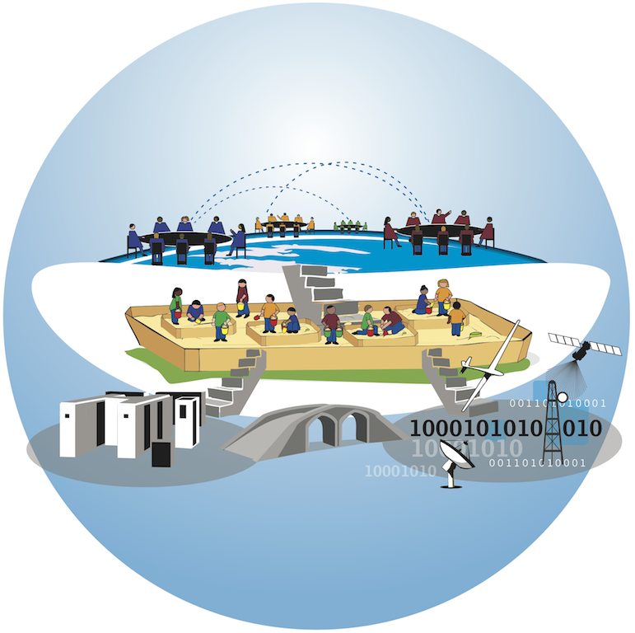
NEX Vision and Goals
Vision: To engage and enable the Earth science community to address global environmental challenges
Goal: To improve efficiency and expand the scope of NASA Earth science technology, research and applications programs
NEX is a collaborative compute platform that improves the availability of Earth science data, models, analysis tools and scientific results through a centralized environment that fosters knowledge sharing, collaboration, innovation and direct access to compute resources.
Engage:
Network, share and collaborate
Discuss and formulate new ideas
Portal, Virtual Institute
Enable:
Access to data
Access to computing
Access to knowledge

